Slide 1

Control Flow Statements
Conditionals
Loops
Notes:
well.. you have learned code format, how we write beautiful codes, basic principles of python coding, basic data types, collection types and lots of their operations so far. and now you are ready to control your program flow. what is the controlling of your program flow. does anyone have an idea about this? what is the meaning of the controlling your program. ok.
think like this : suppose You have some lines of code in your program and you want these lines to be run under certain conditions. Or suppose you have some lines of code and you want them to run a certain number of times and over and over again in loop. That's where the control flow statement comes into play. ok. let’s see them in detail, starting with conditionals.

Slide 2
Conditional Statements

Slide 3
Table of Contents
Structure of the if Statements
Comparison Operators
if-else Statements
if-elif-else Statements
Nested if-elif-else Statements
Notes:
the subtopics that i am gonna cover within this lecture are shown on the screen….

Slide 4
Structure of the if Statements
1
if a > b :
print('a is greater than b')

Slide 5
Structure of the if Statements
The basic structure 👇 of an if statement is :
if condition:
body
A colon
A 4-space indentation
Notes:
the basic if statement that we use in python is shown on the screen. as you can see we have keyword if and space and condition and colon then body comes with 4 space indentation. keep in mind that colon and indentation are important and in general people forgets to use it in a correct way. so use this syntax in a correct way that shown on the screen.
In some cases, your program needs to execute some part of the code only if a specific condition is true.
The if statements check the condition. The condition is always a Boolean expression, that is, its value equals either True or False.
If it evaluates to True, it executes the body of the if statement. If it evaluates to False, it skips the body and jump to the next line. This logic works like the English language. clear? let’s consolidate our knowledge throughout several examples as we do usually.

Slide 6
Structure of the if Statements
Here’s the simple pre-class examples of the if Statements :
Notes:
if True:
print('it is true')

Slide 7
Structure of the if Statements
Here’s the simple pre-class examples of the if Statements :
Notes:
you know what? do you like hamburgers? how about we cook a hamburger. ok. let’s cook a hamburger all together.
if True:
print('it is true')

Slide 8
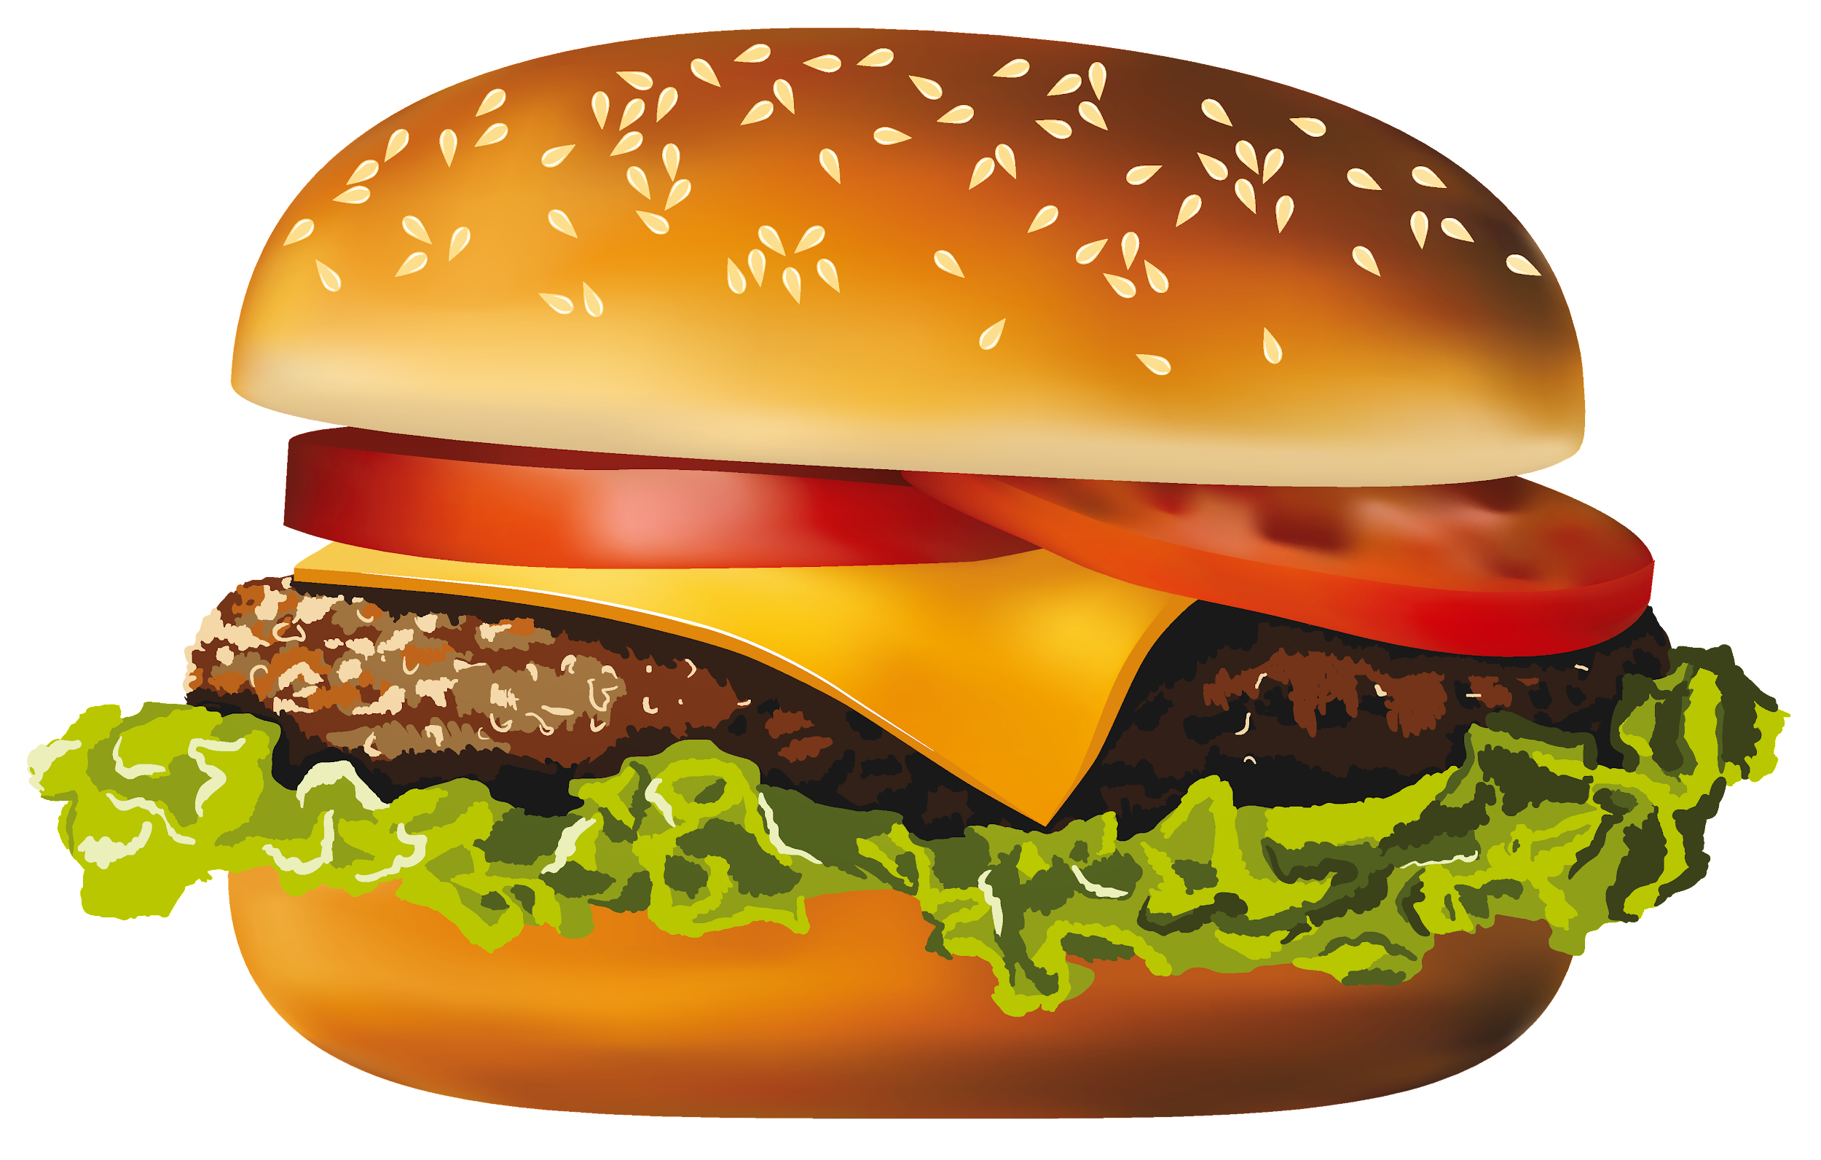
if Statements
Task : Cooking a hamburger.
We need some ingredients that are not in our kitchen.
There is only one grocery store in our village and its availability is crucial.
Ingredients (stated below) required for cooking hamburgers with greens (it does not matter which one. lettuce / onion)
Set a logical boolean algorithm onto hamburger to be able to eat.
Set a condition hamburger variable with if statement that gives us a message “Bon Appetit.” if we can cook hamburger, do nothing if we can not.
#ingredients and requirements:
minced meat (must)
hamburger bread (must)
lettuce
onion
grocery store (must)
(must)
Notes:
Let's see if we can be successful. by the way i love to eat hamburgers. who doesn’t, right? anyway. let’s start. read the task carefully…
what you need to do in this task is that : you need to set conditional statement which displays a message “bonapeti” if we meet all the requirements. if do not meet requirements then do nothing. then what are our requirements : meat, bread, greens and store.
think of all these requirements as variables. and all these variables can accept only boolean values, True or False. it is up to you what you will assign to these variable. the only thing that you should do is that the value can only be True or False.
and of course we should set the boolean logical syntax onto hamburger variable. we have a variable that represents condition named hamburger. if the hamburger will be True then print bonapeti, if the hamburger variable is False then the body will not be executed so does nothing

Slide 9
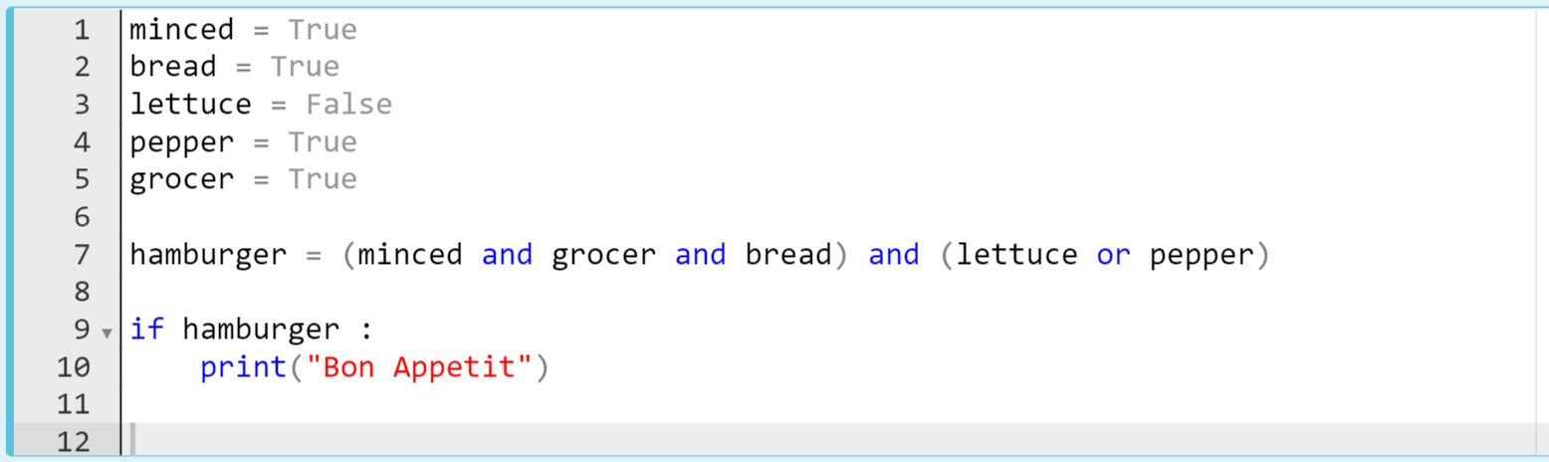
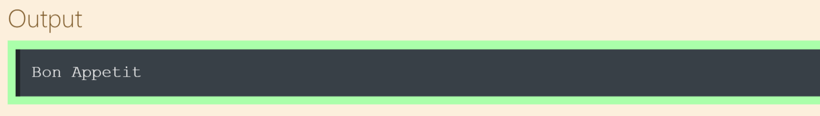
if Statements
The code can be like:
⚠ The values (True/False) are up to you
Notes:
...does it make sense
minced = True
bread = True
lettuce = False
pepper = True
grocer = True
hamburger = (minced and grocer and bread) and (lettuce or pepper)
if hamburger:
print('Bon Appetit')

Slide 10
Comparison Operators
2
Notes:
Let’s take a quick look at the comparison operators.

Slide 11
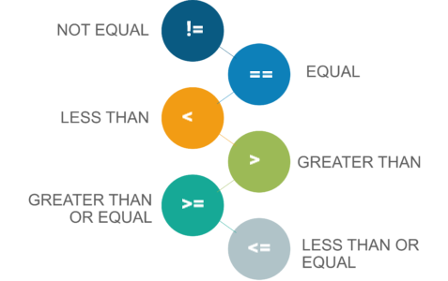
Comparison Operators
These Operators return True or False
⚠
Notes:
now it is my turn. here are the definitions. and i would like to emphasize one more time that when you use one these operators you have to know that the result always will be True or False. This is very very important understanding of boolean and conditional operations in python. keep in mind please.

Slide 12
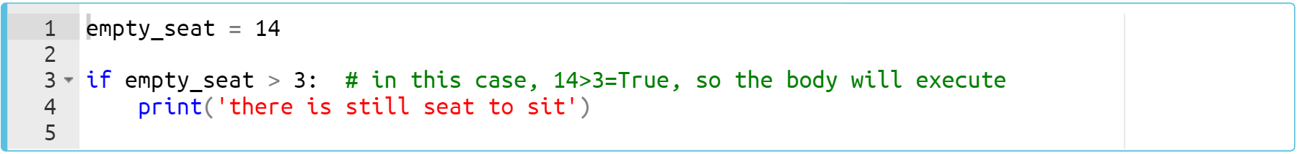
Comparison Operators
Here’s the simple pre-class examples of the if Statements :
Notes:
…. this syntax, this condition will give true. rigth. what i stated jus now. this comparison operator gives true or false. in this case it gives true. so it will execute the body.
empty_seat = 14
if empty_seat > 3:
print('there is still seat to sit')

Slide 13
Comparison Operators
Here’s the simple pre-class examples of the if Statements :
comparison operator
Notes:
empty_seat = 14
if empty_seat > 3:
print('there is still seat to sit')

Slide 14
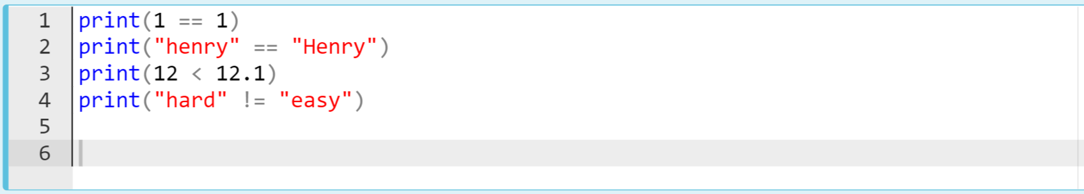
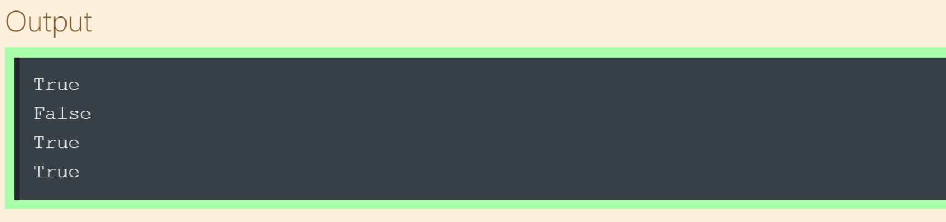
Comparison Operators
Take a look at the following examples :
Notes:
… does it make sense?
print(1 == 1)
print('henry' == 'Henry')
print(12 < 12.1)
print('hard' != 'easy')

Slide 15
Comparison Operators (review)
Opr. | How it works ? | Sample
== | Returns True if two values are equal or False if different | 2 == 2 (True), 2 == 3 (False)
!= | Returns True if two values are not equal or False if equal | 2 != 2 (False), 2 != 3 (True)
> | Returns True if the value on the left is greater than the value on the right otherwise returns False | 3 > 2 (True), 2 > 3 (False)
< | Returns True if the value on the left is less than the value on the right otherwise returns False | 2 < 3 (True), 3 < 2 (False)
>= | Returns True if the value on the left is greater than or equal to the value on the right otherwise returns False | 3 >= 2 (True), 3 >= 3 (True), 2 >= 3 (False)
<= | Returns True if the value on the left is less than or equal to the value on the right otherwise returns False | 3 <= 2 (False), 3 <= 3 (True), 2 <= 3 (True)
Notes:
so i want you to read these table again. it is from your pre-class content. so that, you will review them. i am giving you one minute to finish this.

Slide 16
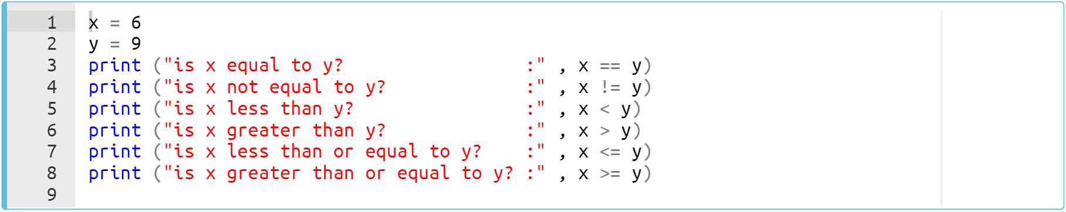
Comparison Operators
Let’s examine the following pre-class example carefully :
Notes:
so how about this? let’s see the output directly.
x=6
y=9
print('is x equal to y? :', x==y)
print('is x not equal to y? :', x!=y)
print('is x less than y? :', x<y)
print('is x greater than y? :', x>y)
print('is x less than or equal to y? :', x<=y)
print('is x greater than or equal to y? :', x>=y)

Slide 17
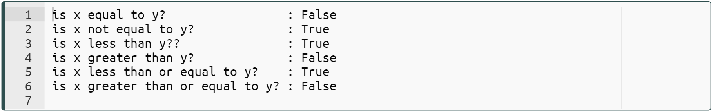
Comparison Operators
Let’s examine the following example carefully :
Notes:
x=6
y=9
print('is x equal to y? :', x==y)
print('is x not equal to y? :', x!=y)
print('is x less than y? :', x<y)
print('is x greater than y? :', x>y)
print('is x less than or equal to y? :', x<=y)
print('is x greater than or equal to y? :', x>=y)

Slide 18
Comparison Operators
Task :
Create two sets (using set() function) with the given string values below.
Compare these sets and print out 'We are the same!' if they are equal, do nothing if they are not.
"TWELVE PLUS ONE"
"ELEVEN PLUS TWO"
Notes:
…. you know, understanding of the problem or task or the project is crucial. keep in mind please. so that, you can reach the solution in the correct way. ok. …
set1 = set('TWELVE PLUS ONE')
set2 = set('ELEVEN PLUS ONE')
if set1 == set2:
print('We are the same!')

Slide 19
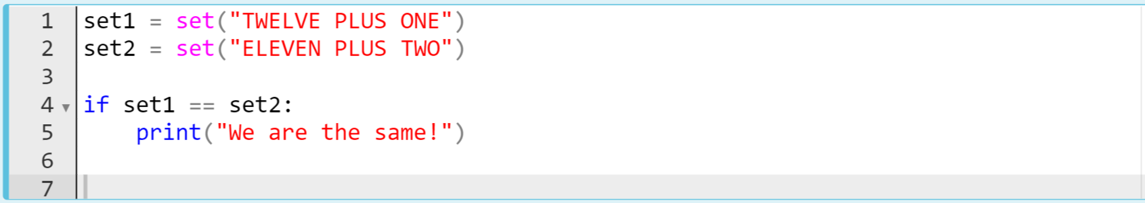
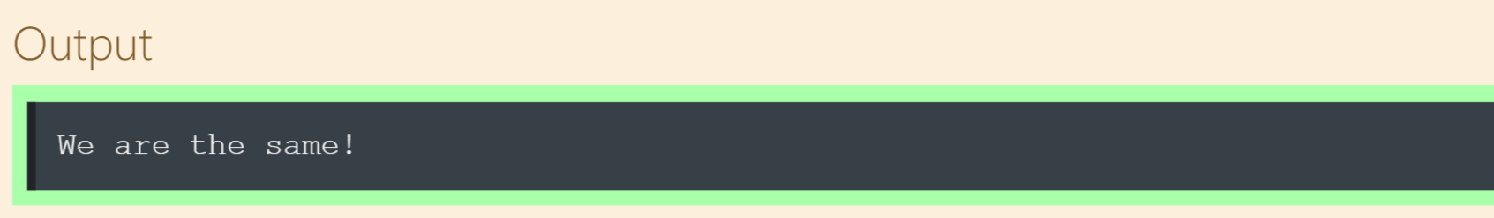
Comparison Operators
The code might be like :
Notes:
ok let’s see how i solve this task….
when we print out the set1 and set2 we can see that all elements of these two sets are exactly the same. so the condition gives true and execute the body which is the print statement. then we have a sentence as a result. did i make myself clear.
set1 = set('TWELVE PLUS ONE')
set2 = set('ELEVEN PLUS ONE')
if set1 == set2:
print('We are the same!')

Slide 20
if-else Statements
3
Notes:
yes. after getting familiar with the basic structure of if statement, now we are gonna cover a little bit more complicated structure of if statement.

Slide 21
if-else Statements(review)
The simple structure 👇 of an if-else statement is :
if condition1:
execute body1
else:
execute body2
Notes:
An if-else statement is another kind of conditional statements in Python. It is used with an additional keyword: else.
else works like an if statement. If none of the conditions in if are ensured, "else" will be used to specify all remaining conditions.
Let me put it in a different word: my friends. if we meet the condition then it will execute body1 otherwise it will execute body2.
Does it make sense? lets consolidate this structure in several examples

Slide 22
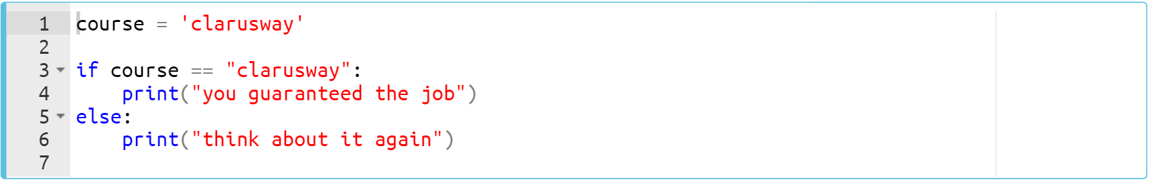
if-else Statements(review)
Let’s take a look at this pre-class example of an if-else statement :
Notes:
course = 'clarusway'
if course == 'clarusway':
print('you guaranteed the job')
else:
print('think about it again')

Slide 23
if-else Statements
Let’s take a look at this example of an if-else statement :
Notes:
course = 'clarusway'
if course == 'clarusway':
print('you guaranteed the job')
else:
print('think about it again')

Slide 24
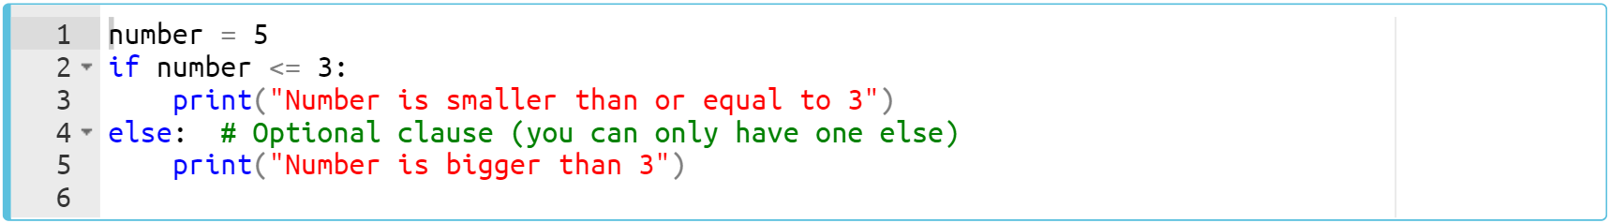
if-else Statements(review)
Here’s another pre-class example of an if-else statement :
Notes:
now it is your turn. train your brain. and shoot your responses
number = 5
if number <=3:
print('Number is smaller than or equal to 3')
else:
print('Number is bigger than 3')

Slide 25
if-else Statements
Here’s another example of an if-else statement :
Notes:
number = 5
if number <=3:
print('Number is smaller than or equal to 3')
else:
print('Number is bigger than 3')

Slide 26
if-else Statements
Task : Python Program to Check if a Number is Odd or Even
Write a program to check whether a number entered by the user is even or odd.
Print the result such as : “2 is even”
Notes:
and consider this task my friends. ….
how about specifying the numbers as odd or even. how we do that? remember?
yes. bingoo. we should use modulus operator.
num = int(input('Enter a number: '))
if (num % 2) == 0:
print('{0} is Even'.format(num))
else:
print('{0} is Odd'.format(num))

Slide 27
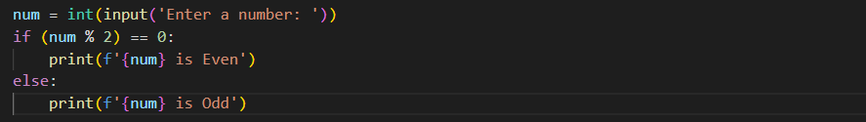
if-else Statements
The code might be like :
Notes:
…. input function takes a value from the user and assign it to a variable. in this case variable num. by the way keep in mind that: input function always take a value as string type. so we have to convert this string type value to any type that we need in our program. in this case we need integer type so we convert it to int type to use in our program. … ok … how the modulus works. it returns the remainder of a division, right? so. when we divide a number to 2 then if there are a remainder, it is odd, if there is no remainder which means it is zero then the number is even. ok after this quick review and explanation, let’s keep going….
There is not just one way to get the right result. there are many…
num = int(input('Enter a number: '))
if (num % 2) == 0:
print(f'{num} is Even')
else:
print(f'{num} is Odd')

Slide 28
if-else Statements
Task : Python Program to Check if a Number is Negative or Positive.
Write a program to check whether a number entered by the user is negative or positive. Number zero is not acceptable.
Print the result such as : 'Positive number”
Notes:
num = float(input('Enter a number: '))
if num > 0:
print('Positive number')
else:
print('Negative number')

Slide 29
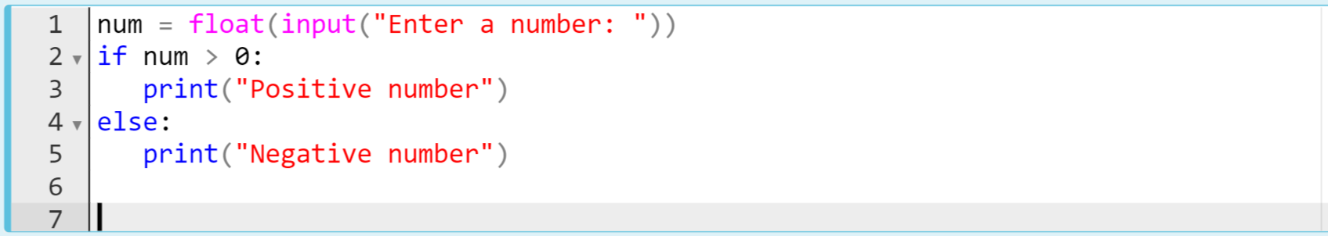
if-else Statements
The code might be like :
Notes:
…. due to meet all the options entered by users, i have decided to convert string type value into a float type. it makes sense, right? you can do it by integer, as well but floats is much better i think…
num = float(input('Enter a number: '))
if num > 0:
print('Positive number')
else:
print('Negative number')

Slide 30
if-else Statements
Task : Python Program to Check which number is larger.
Write a program that prints which of the two numbers the user entered is large.
Print the result such as : “The large number is 4”
Notes:
num1 = float(input('Enter first number: '))
num2 = float(input('Enter second number: '))
if (num1 > num2):
larger = num1
else:
larger = num2
print('The large number is', larger)

Slide 31
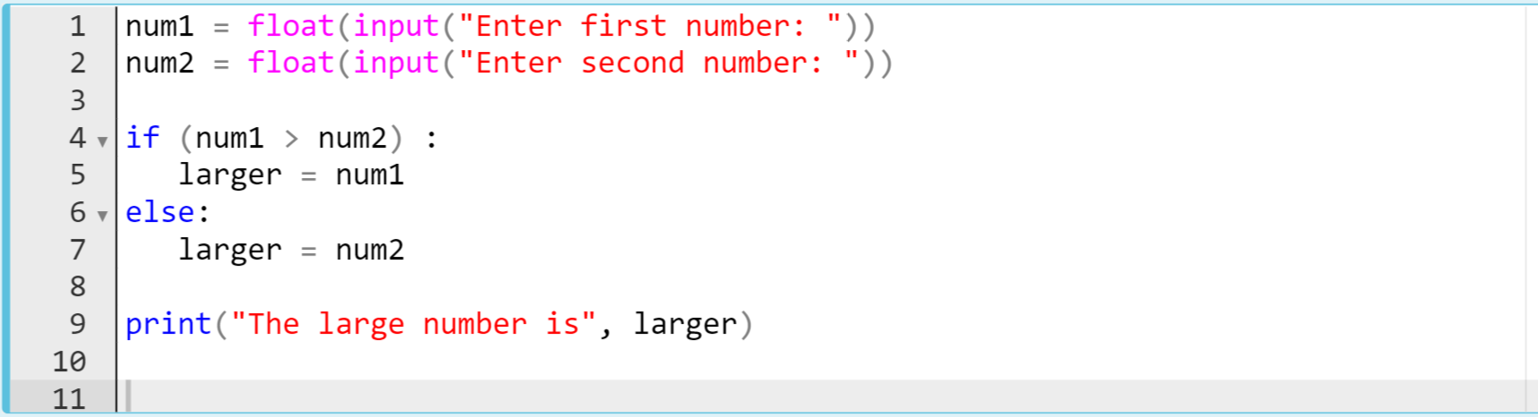
if-else Statements
The code might be like :
Option-1
Notes:
num1 = float(input('Enter first number: '))
num2 = float(input('Enter second number: '))
if (num1 > num2):
larger = num1
else:
larger = num2
print('The large number is', larger)

Slide 32
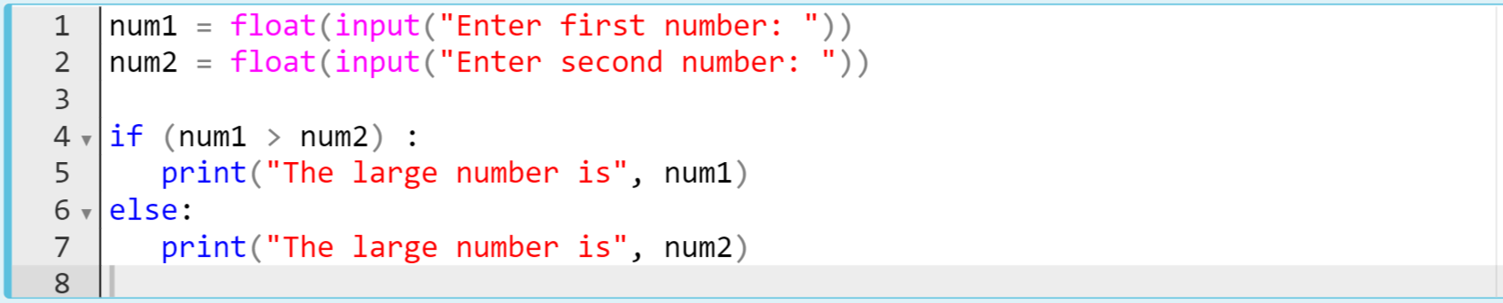
if-else Statements
The code might be like :
Option-1
Option-2
Notes:
num1 = float(input('Enter first number: '))
num2 = float(input('Enter second number: '))
if (num1 > num2):
larger = num1
else:
larger = num2
print('The large number is', larger)
num1 = float(input('Enter first number: '))
num2 = float(input('Enter second number: '))
if (num1 > num2):
print('The large number is', num1)
else:
print('The large number is', num2)

Slide 33
if-else Statements
Task : Convert boolean True to string value of "Yes", convert boolean False to string value of "No".
Write a program that ;
Converts the type of the variable bool_value which keeps True / False to Yes or No.
True → ”Yes”
False → ”No”

Slide 34
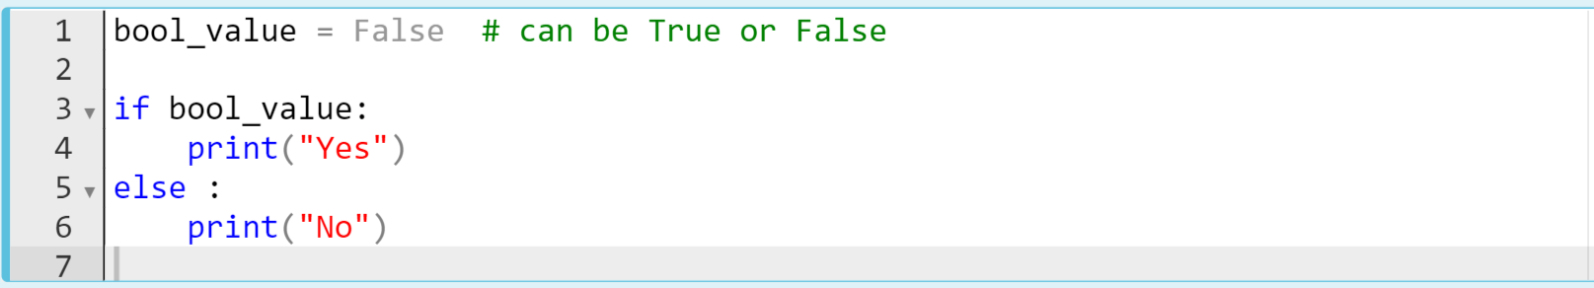
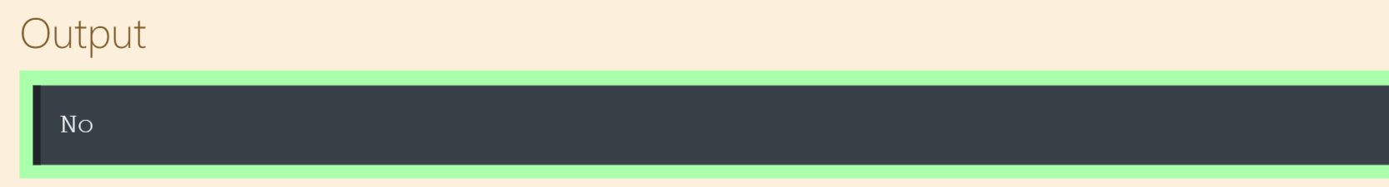
if-else Statements
The code might be like :
Notes:
… according to the task i do not take a value from the user. actually, we cannot take boolean value using input function. so. we define a variable and it can take either true or false. in this case we assigned it false…
bool_value = False
if bool_value:
print('Yes')
else:
print('No')

Slide 35
if-elif-else Statements
4
Notes:
yes we are going through step by step. now it is time to learn a little bit more complicated structure of if statements. i hope that you are already familiar with it, aren’t you? well then. let’s see your pre-class knowledge.

Slide 36
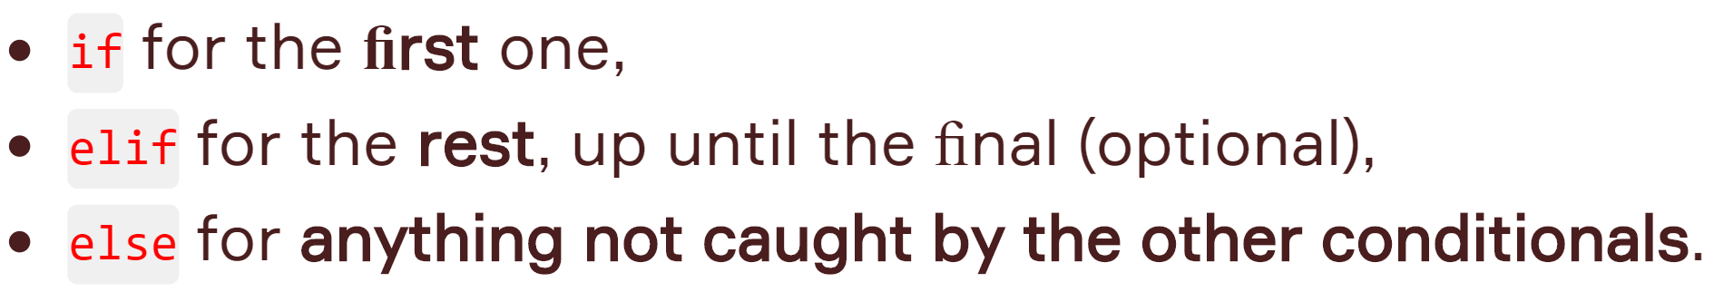
if-elif-else Statements (review)
You can define a series of conditionals.
Notes:
The elif statement is used when it requires to specify several conditions in our program.
In Python you can deﬁne a series of conditionals as follows.

Slide 37
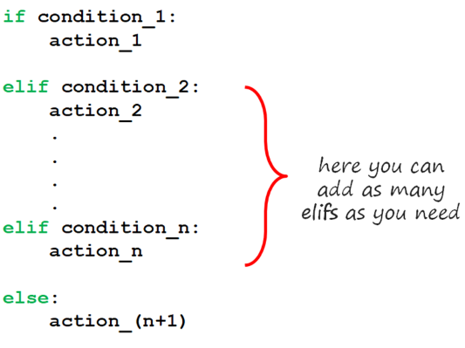
if-elif-else Statements (review)
The simple and common structures of an if-elif-else statement are:
if condition1:
execute body1
elif condition2:
execute body2
else:
execute body3
Notes:
this is the structure of if elif else statement. …. as you see on the screen, you can use as many elifs as you want to use. it is not limited to only one. you can use more than one, depending on your needs. the python starts ro read the codes from top to end line by line. so first it checks if statement and if the condition is true then execute body one. if the condition one is false then it checks the first elif statement. the condition two is true then it will execute the body two if not it goes to the next line. if there are other elifs then it checks all of them until else statement. if all condition syntaxes above the else statement do not meet the condition then there is only one option left. else statement. so it executes else body. ok. if you want let’s dive into several examples for better understanding.

Slide 38
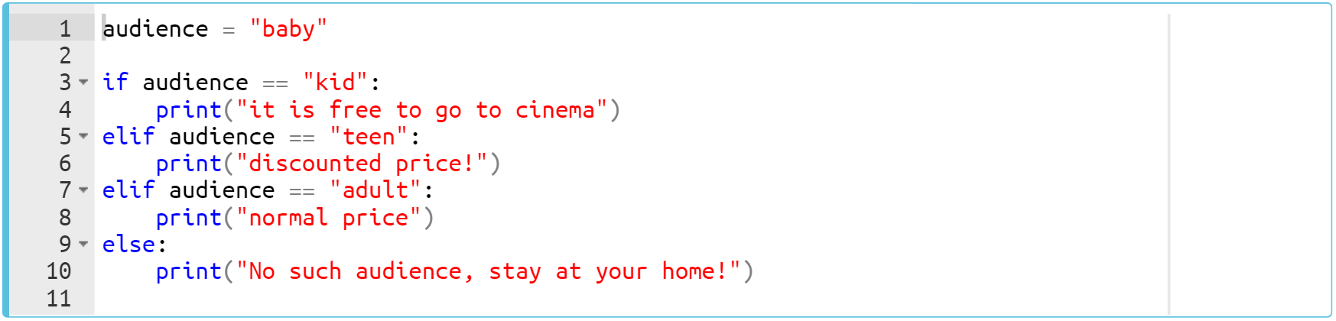
if-elif-else Statements (review)
Consider this pre-class example :
Notes:
… i give you thirty seconds to complete it
audience = 'baby'
if audience == 'kid':
print('it is free to go to cinema')
elif audience == 'teen':
print('discounted price!')
elif audience == 'adult':
print('normal price')
else:
print('No such audience, stay at your home!')

Slide 39
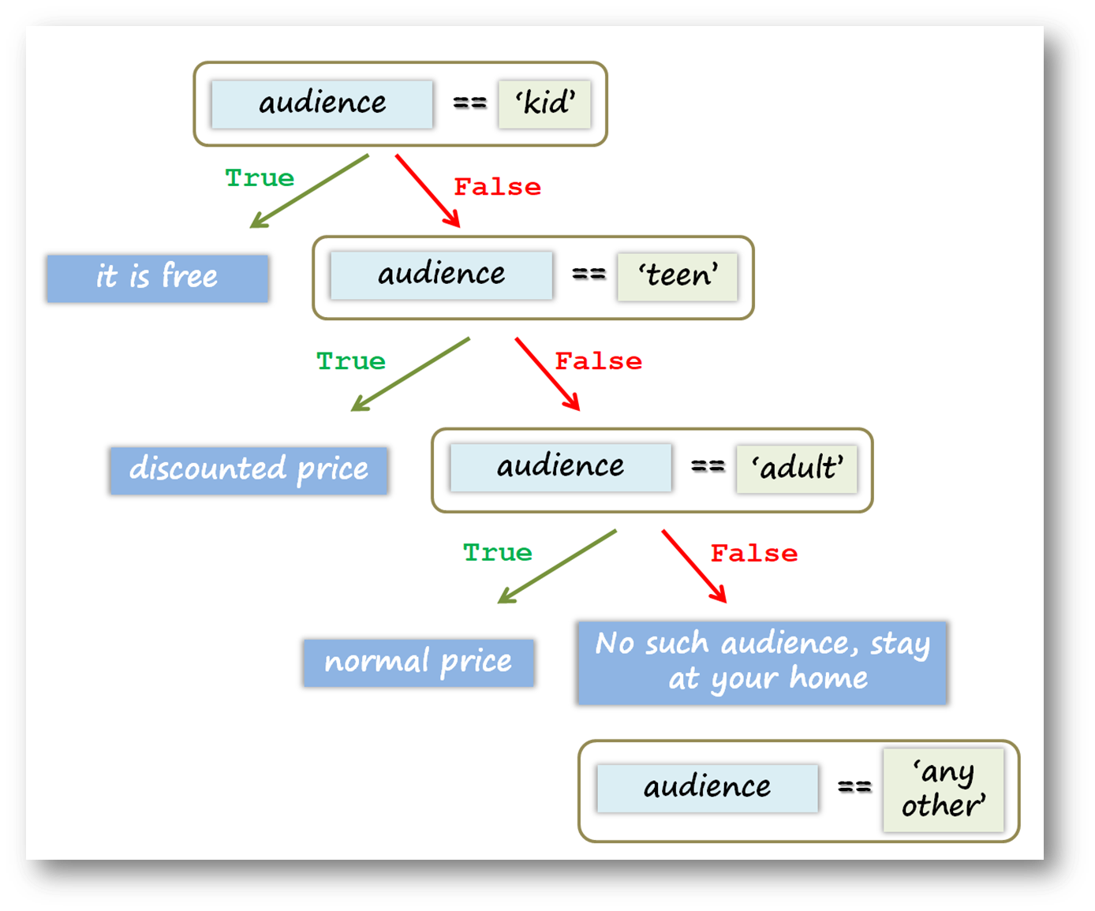
if-elif-else Statements (review)
Let’s examine this diagram of previous example :
Notes:
if you want, let’s follow the execution process step by step. so that, we can understand better. ...

Slide 40
if-elif-else Statements (review)
The output :
Notes:
audience = 'baby'
if audience == 'kid':
print('it is free to go to cinema')
elif audience == 'teen':
print('discounted price!')
elif audience == 'adult':
print('normal price')
else:
print('No such audience, stay at your home!')

Slide 41
if-elif-else Statements
Task : Write Python Program to Find the Largest Among Three Numbers
Write a program that prints which of the three numbers the user entered is the largest.
Print the result such as : “The largest number is 4”
Notes:
ok. what we have here in our task. read it carefully...
...think simple, do not start your coding in complicated way..
num1 = float(input('Enter first number: '))
num2 = float(input('Enter second number: '))
num3 = float(input('Enter third number: '))
if (num1 >= num2) and (num1 >=num3):
largest = num1
elif (num2 >= num1) and (num2 >=num3):
largest = num2
else:
largest = num3
print('The largest number is', largest)

Slide 42
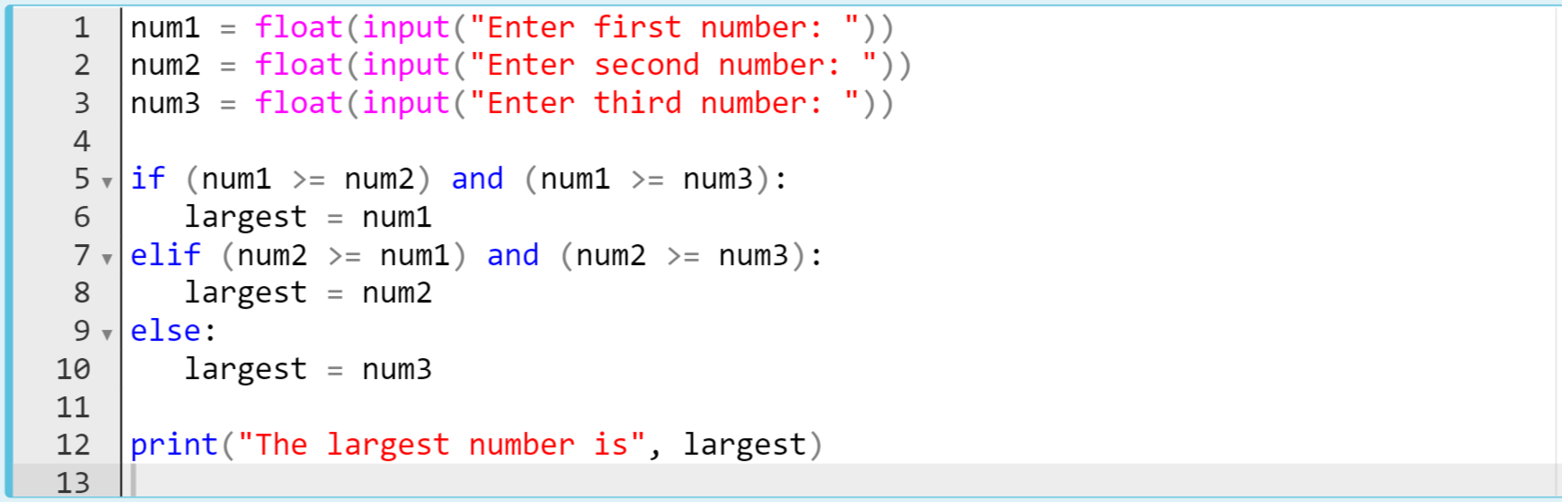
if-elif-else Statements
The code might be like :
Notes:
num1 = float(input('Enter first number: '))
num2 = float(input('Enter second number: '))
num3 = float(input('Enter third number: '))
if (num1 >= num2) and (num1 >=num3):
largest = num1
elif (num2 >= num1) and (num2 >=num3):
largest = num2
else:
largest = num3
print('The largest number is', largest)

Slide 43
if-elif-else Statements
Task : Write Python Program to Check if a Number is Negative, Positive or Zero.
Write a program to check whether a number entered by the user is negative, positive or zero.
Print the result such as : “Negative number” or “Zero”.
Notes:
num = float(input('Enter a number: '))
if num > 0:
print('Positive number')
elif num == 0:
print('Zero')
else:
print('Negative number')

Slide 44
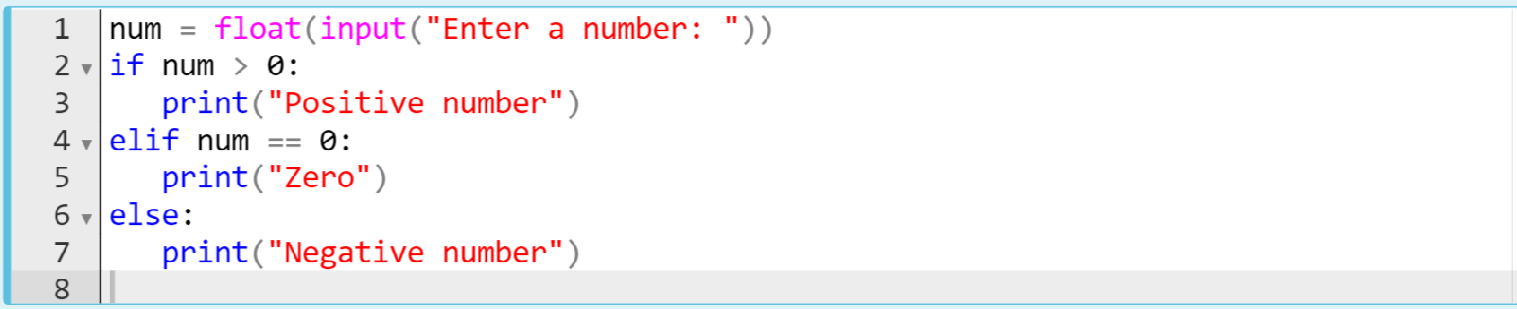
if-elif-else Statements
The code might be like :
Notes:
…. why we compare the variable with zero. because the zero is our touchstone our threshold. …
num = float(input('Enter a number: '))
if num > 0:
print('Positive number')
elif num == 0:
print('Zero')
else:
print('Negative number')

Slide 45
Nested if-elif-else Statements
5
Notes:
yess. it is widely used in python. in some cases we need to establish a condition based on other condition. think of the traffic lights. if the light system is working then there can be nested conditions based on the availability of the lights. out of order or not. if it is working then if it red stop, if it is green pass, if it is yellow get ready. these are nested conditions. so. if the lights is out of order then do something. ok. let’s dive into several examples

Slide 46
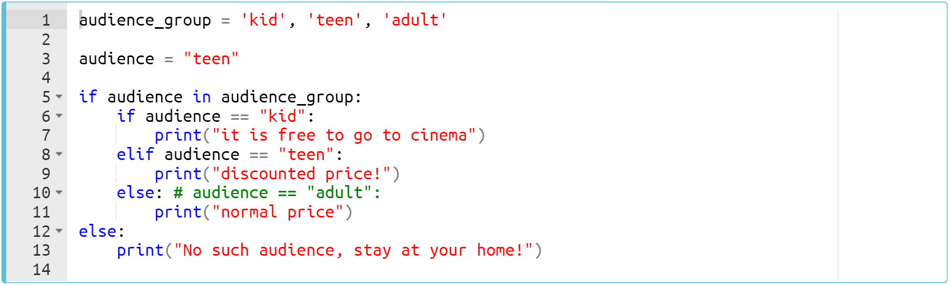
Nested if-elif-else Statements
Nested structure of pre-class examples.
Notes:
audience_group = 'kid', 'teen', 'adult'
audience = 'teen'
if audience in audience_group:
if audience == 'kid':
print('it is free to go to cinema')
elif audience == 'teen':
print('discounted price!')
else: #audience == 'adult'
print('normal price')
else:
print('No such audience, stay at your home!')

Slide 47
Nested if-elif-else Statements
In this case, the output is :
Notes:
audience_group = 'kid', 'teen', 'adult'
audience = 'teen'
if audience in audience_group:
if audience == 'kid':
print('it is free to go to cinema')
elif audience == 'teen':
print('discounted price!')
else: #audience == 'adult'
print('normal price')
else:
print('No such audience, stay at your home!')

Slide 48
Nested if-elif-else Statements
Let’s write a program that asks you to enter your exam score and calculates the range in which your degree is based on your exam score. The output would be: e.g, “Your degree is B+”
95 and above ▶▶ “A+”
90-94 ▶▶ “A”
85-89 ▶▶ “B+”
80-84 ▶▶ “B”
79 and below ▶▶ “below B” or “B-”
⚠Use nested if-statement.
Notes:
score = int(input('Enter your score :'))
if score >=90:
if score >=95:
Score_letter='A+'
else:
Score_letter='A'
elif score >=80:
if score >=85:
Score_letter = 'B+'
else:
Score_letter = 'B'
else:
Score_letter = 'below B'
print('Your degree: %s' % Score_letter)

Slide 49
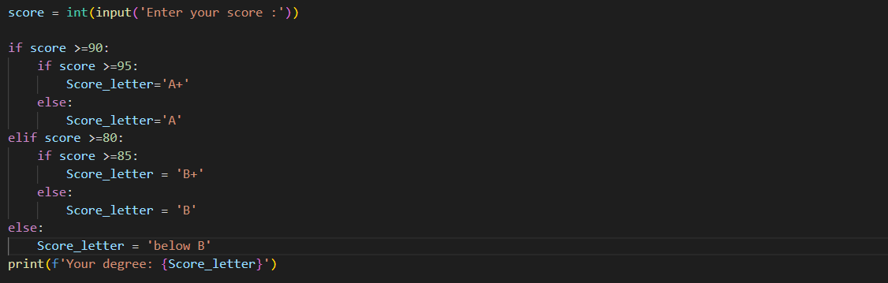
Nested if-elif-else Statements
The one of the solution code may be like :
Notes:
score = int(input('Enter your score :'))
if score >=90:
if score >=95:
Score_letter='A+'
else:
Score_letter='A'
elif score >=80:
if score >=85:
Score_letter = 'B+'
else:
Score_letter = 'B'
else:
Score_letter = 'below B'
print(f’Your degree: {Score_letter}’)

